Slide 1
Counting
CSE-103: Discrete Mathematics

Slide 2
Counting Basics
Two basic counting principles are:
Sum Rule
Product Rule
2

Slide 3
The Product Rule
Suppose that a procedure can be broken down into a sequence of two tasks. If there are n₁ way to do the first task and for each of these ways of doing then first task there are n₂ ways of doing the second task, then there are n₁ n₂ ways to do the procedure.
Example: The chairs of an auditorium are to be labeled with a letter and a positive integer not exceeding 100. what is the largest number of chairs can be labeled differently?
Solution: To label a chair we can use any one from 26 letters in alphabet and then assign one of the 100 possible integer. According to product rule the largest number of chairs that can be labeled is
26 . 100 = 2600.
3

Slide 4
The Sum Rule
If a procedure can be done either in one of n₁ ways or in one of n₂ ways, where none of the set of n₁ ways is same as any of the set n₂ ways, then there are n₁ + n₂ ways to do the task.
Example: A student can choose a project from one of the three lists. The three lists contain 23, 15 and 19 possible projects, respectively. No project is on in more than one list. How many possible projects are there to choose from?
Solution: A student can choose any one project from any one of the three list. As there is no common project in one of the lists, according to sum rule a student can choose project in 23 + 15 + 19 = 57 ways.
4

Slide 5
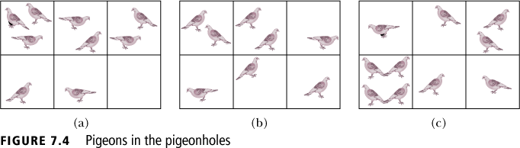
The Pigeonhole Principle
If k is a positive integer and k + 1 or more objects are placed into k boxes, then there is at least one box containing two or more of the objects.
The pigeonhole principle is also known as the Dirichlet drawer principle, or the shoebox principle.
5

Slide 6
Examples-- Pigeonhole Principle
Question: How many students must be in a class to guarantee that at least two students will get same score in the final exam, if the exam is graded on a scale from 0 to 100?
Answer: There are 101 possible score in the exam. According to pigeonhole principle there must be at least 102 students to get 2 students with same score.
6

Slide 7

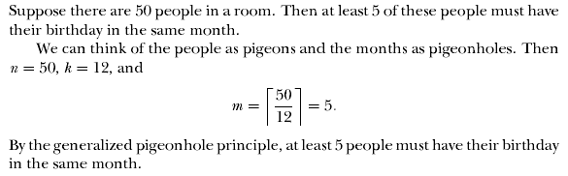
Generalized Pigeonhole Principle
If N objects are objects are into k boxes, then there are at least one box containing at least objects.
Example:
7

Slide 8
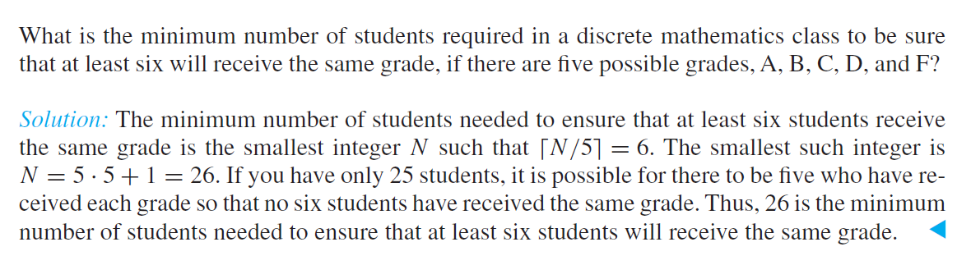
Generalized Pigeonhole Principle
If N objects are objects are into k boxes, then there are at least one box containing at least objects.
Example:
8

Slide 9
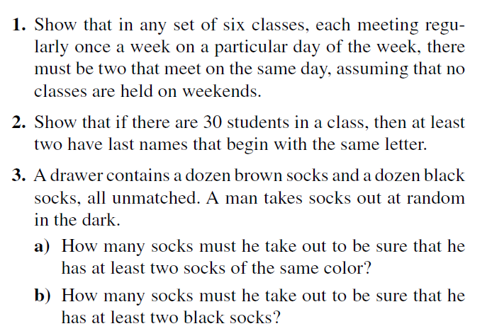
Generalized Pigeonhole Principle
9

Slide 10


Permutations
A permutation of a distinct objects is an ordered arrangement of those objects
10

Slide 11
Example -- permutation
Let S = {a, b, c}. The 2-permutation of S are ordered arrangements a, b; a, c; b, a; b, c; c, a; and c, b. i. e. there are six 2-permutation of the three elements .
For the first element there are three ways to choose then two ways to choose the second element of the element because it must be different from the first element.
P(3, 2) = 3. 2 = 6
11

Slide 12
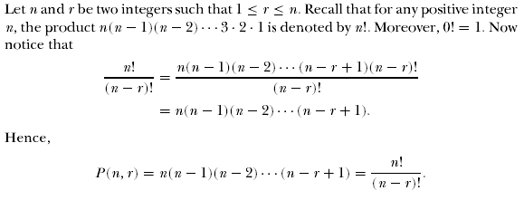
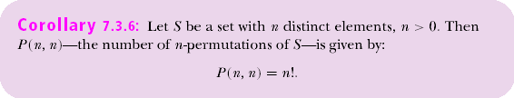
Permutations
12

Slide 13
Example-- Permutation
Question: How many ways are there to select a 1st prize, 2nd prize and 3rd prize winner among 100 people participating in a contest?
Answer: The number of ways to select three prize winner is the number of ordered selection of three elements from a set of 100 elements, i.e. the 3-permutation of 100 elements:
P(100, 3) = 100! / (100 - 3)! = (100. 99. 98. 97!)/ 97! = 100. 99. 98 = 970200.
Question: How many permutation of the letters ABCDEFGH contain the block ABC?
Answer: ABC occur in a block and the rest of individual letters are D, E, F, G, and H; i. e. total six letters can occur in any order, there is
6! = 6. 5. 4. 3. 2. 1= 720 permutation of the letters ABCDEFGH contain the block ABC.
13

Slide 14
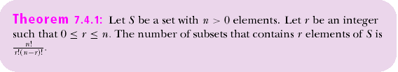


Combinations
An r-combination of elements of a set is an unordered selection of r elements from the set.
14

Slide 15
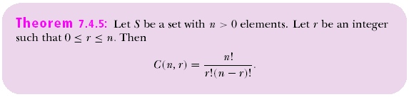
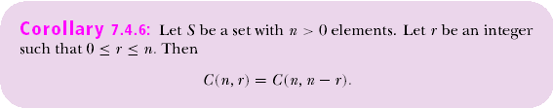

Combinations
15

Slide 16
Example- Combination
Question: How many different committees of three student can be formed from a group of four student?
Answer: We have to select three student from four students in any order, i.e. 3-combination of 4 elements:
C(4, 3) = 4!/3!(4 - 3)! = (4. 3!)/ 3!. 1! = 4
Question: A group of 30 people has been trained as astronauts to go to the 1st mission on Mars. How many ways to select a crew of six people to go to the mission?
Answer: As we assume all the crew have same job, so it is 6-combination of 30 elements, the order of the people chosen does not matter. Thus:
C(30,6) = 30!/6!(30-6)! = (30.29.28.27.26.25)/(6.5.4.3.2.1)= 593775
16

Slide 17
Thank You
Study all the solved problem from your text book.
Try to solve related problems from exercise.

